Slide 1
The Audubon Water Wise Project in Honor of Mal Welch Saving Money & Saving Water
What Are Intelligent Irrigation Controllers:
How Do They Work & What Can I Expect
https://www.youtube.com/watch?v=yeRQF79mb_o

Slide 2
Agenda
The Audubon Water Wise Project
In Cooperation with TLA Strategic Water Committee
Water: Why Conserve It?
Picking the “Low Hanging Fruit”. . . Smart Irrigation Controllers
A (Quick) Controller Review
Open Questions & Answers

Slide 3
Aquifer Profile
Notes:
Upper = 200 to 700 feet deep
Lower = +1,000 feet deep

Slide 4
Permits to Draw for the Floridan Aquifer
Notes:
Chatham Co. in “Cone of Depression”

Slide 5
Shallow Well Water
Conserves Potable Drinking Water, but . . .
Can Deplete Ground Water and Risks Salt Water Intrusion
How a “Smart” Controller Can Help . . .
Extend Pump Life (less run time)
Lower Electricity Bills
Possibly Less “Rust Stains”
Healthier Lawn: No Over Watering = No Fertilizer Wash-Out

Slide 6
Solutions to Conserve Our Water Resources
Approx. 50% of Our Potable Water is Estimated to be Irrigation or ‘Other’
Irrigation Going Off In or After a Rain Strom = Waste
Solution: Replace “Dumb” Controllers With “Smart” Ones
What’s Needed :
- Hyper Local Weather Data
- An Internet Connection
- A “Smart” Irrigation Controller

Slide 7
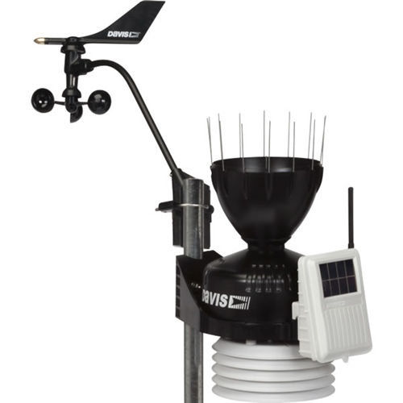
What Are Personal Weather Stations (PWS) ?
WeatherFlow Tempest Station
Davis Vantage Pro2 Station –Skidaway Farms & Marinas

Slide 8
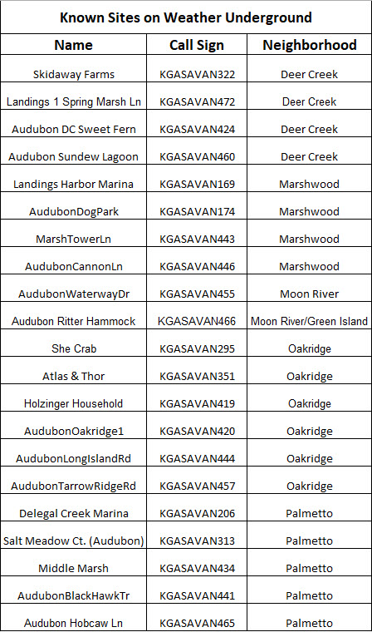
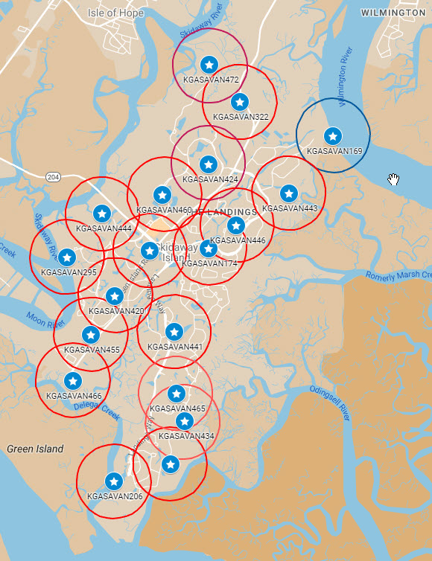
Current Personal Weather Stations (installations of known reliability)
On Going: “Monitor & Maintain”
Nearly Everyone Is Now Within ½ Mile or Less of a Hyper-Local Weather Station
Information available at LandingsWeather.com

Slide 9
Because Weather Is Local: Especially Here
For Example – Our Rainfall N to S (in)
Aug. 25 Sept. 15
Accum. Accum.
North Mark – 0.85 0.06
Cary – 0.76 0.01
Rick – 0.59 0.02
South Tom – 0.40 0.42
near Hunter – 0.03 0.00
near SAV AP- 0.44 0.00
Variations are typical, especially during Summer
Water
Skip

Slide 10
Recent Rainfall Study Results (2024-2025)
19 Month Study Comparing North to South End Rainfall Amounts
- 68% had ¼” or more variance
- 58% had ½” or more variance
- 53% had 1” or more variance
( 26% where above or very near 2” difference )
Confirming that Rainfall Varies Significantly Over the Island

Slide 11
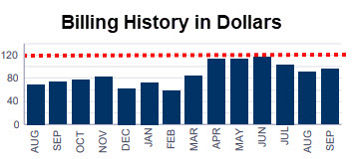
Results of Two Pilot Studies
Mark Warner – Islands of Deer Creek :
Averaging 3.4 skips per month (39%) over the last 3 1/2 months; Saving approx. 6100 gallons/month
(Notes: includes landscape changes & shutting 2 zones. 5 residences now on that PWS via Weather Underground! )
Cary Shapoff – Sweet Fern Retreat, Deer Creek :
August: Skipped - 62% of Runs & 61% of Minutes
(Note: August was wet, Sept. is running about ½ of this so far)
Rick Cunningham - #10 Oakridge :
Dec. 22 thru Aug. 23: Skipped - 49% of Runs & 47% of Minutes
Tom Hamilton – Salt Meadow Ct., Palmetto
Installed 6 years ago; Typical UI Billing > > >

Slide 12
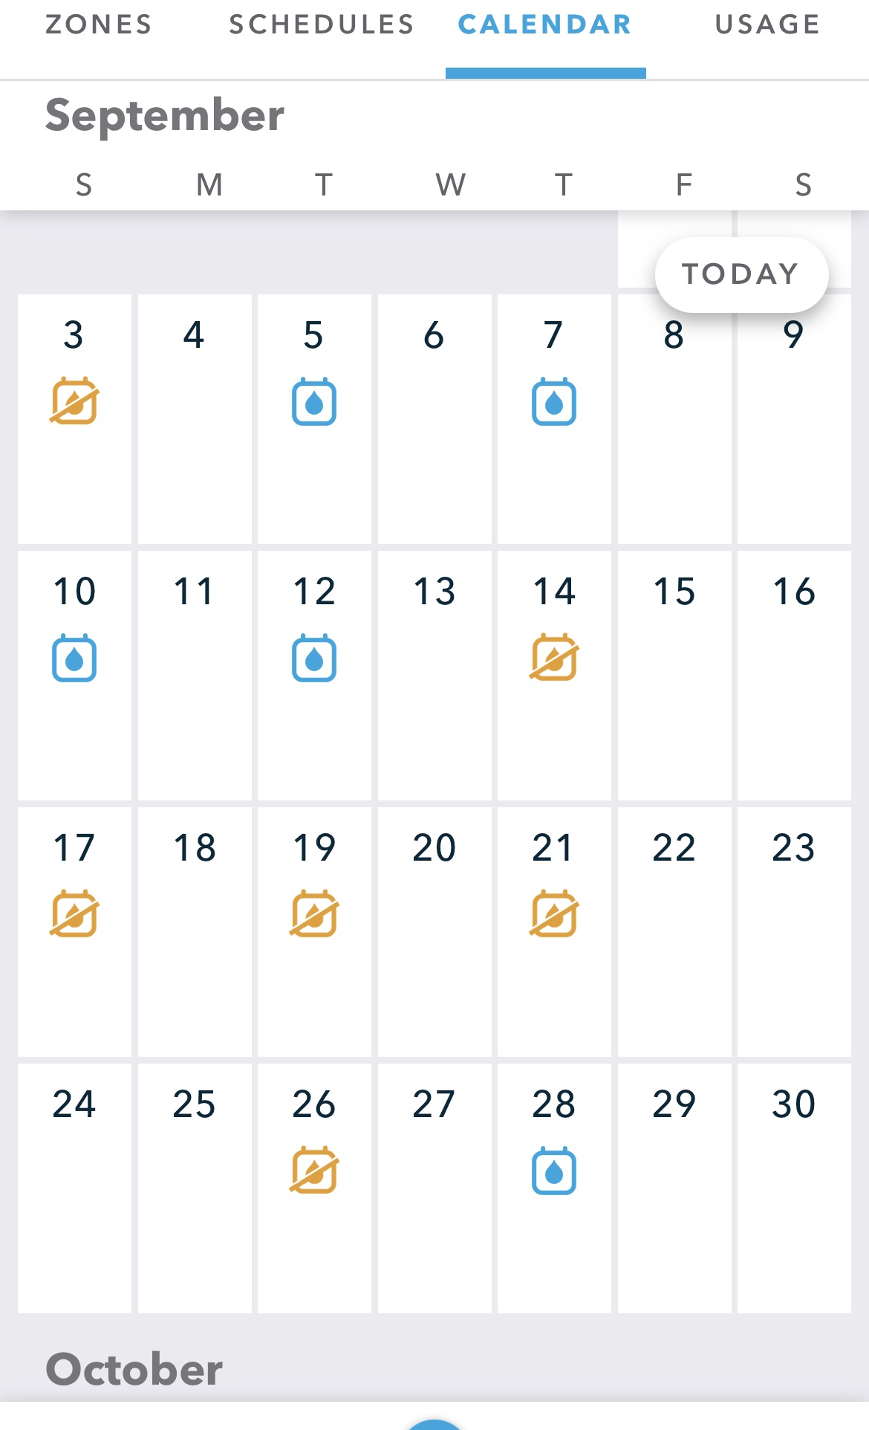
Intelligent Controllers Monitor/Decide – Like You
Manual control (you supply the intelligence!)
if it’s rained enough, or it’s probably going to, or things seem saturated, turn your controller to Off or Pause to skip upcoming cycle(s)
Intelligent Control (IC)
As each scheduled watering cycle approaches, make a decision
Add up actual (very near you!) precipitation plus forecast precipitation (our island)
If greater than the chosen threshold (e.g. ¼ inch), skip this cycle
They operate just like you do, but
They’re “on the job” 24/7
They don’t go out of town
They don’t forget to check the forecast
Adjusts for the Seasons: Less Watering in Cool Months
They tell you what they decide and keep a record that you can review
Water
Skip

Slide 13
Irrigation During Hurricane Milton (really . . .You Can’t Make This Stuff Up)

Slide 14
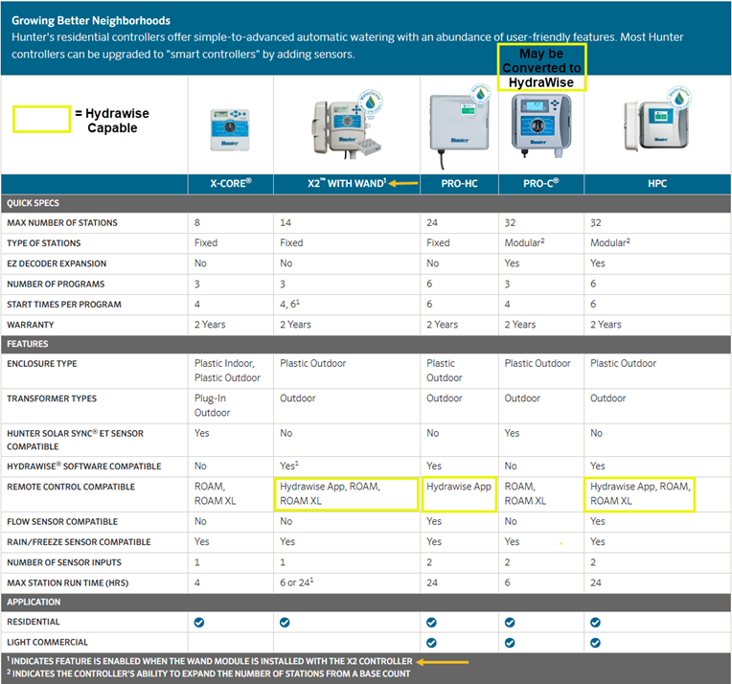
3 Hunter ‘HydraWise’ Controllers
Connects to Local PWS’s, Control via Phone App, Valve Fault Monitoring

Slide 15
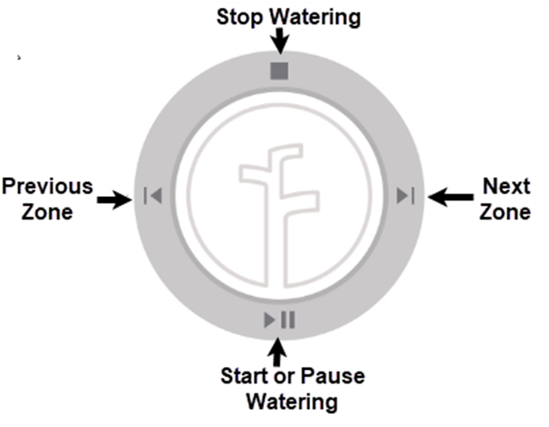
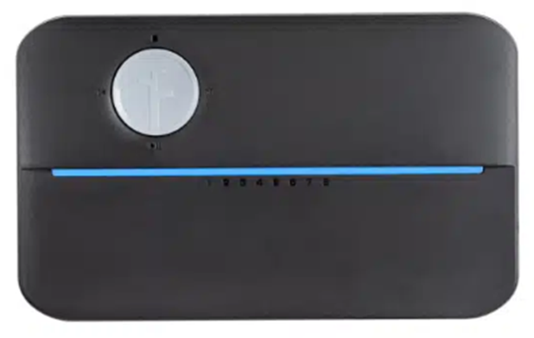
Rachio Controllers
Can be Manually Controlled from
Front Panel ‘Rocker Switch’
2 Models: (consumer & Pro), Connects to Local PWS’s, Control via Phone App, Valve Monitoring

Slide 16
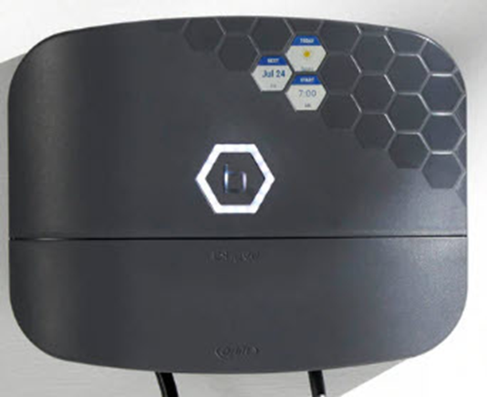
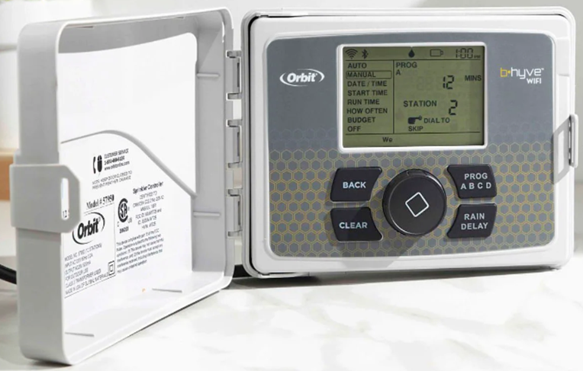
Orbit B-Hyve Controllers
2 Models: w/ & w/o control panel, Connects to Local PWS’s, Control via Phone App

Slide 17
A Quick Controller Review . . .
Note: All of These Controllers Can Operate a Well Pump
Hunter HydraWise Indoor / Outdoor:
Popular With Landscapers, but Make Sure . . .
You Are Connected to Wi-Fi and to a Local Weather Source
(Note: older models might be retrofitted with a Wi-Fi module)
- “Virtual Weather” Vs “Personal Weather Station” Vs “Enthusiast”
Orbit B-Hyve Indoor / Outdoor:
B-Hyve regular (with control panel) 2.4 Ghz Wi-Fi
B-Hyve XR 2.4 & 5.0 Ghz Wi-Fi
Rachio Indoor / Outdoor (w/ box):
- Consumer (clip terminals, valve monitor extra, 2 year warranty)
- Professional (screw terminals, monitoring standard, 4 year warranty)
Note: Both Require Optional Plastic Weatherproof Box IF Mounted Outside

Slide 18
Important Considerations
Controllers should be connected to Nearby Personal Weather Stations
- Close to your house - Not Savannah Airport or other end of island!
- Reliable – properly installed, maintained and monitored.
Audubon has installed a grid of these island wide.
You need a good WiFi connection to controller (to get the forecast)
- If not, inexpensive WiFi extenders are available
Intelligent Controllers Outperform Non-Connected Controllers
- Weather Forecast: What is Predicted
- PWS Weather Data: What Actually Happened

Slide 19
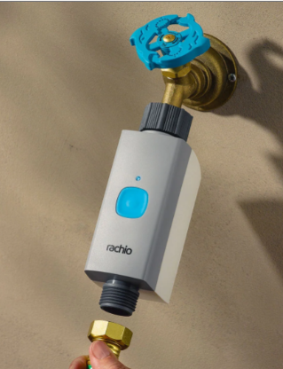
TLA Bulk Rachio Purchase Discount
Receive a Pro Controller for 20% off the price of a regular controller
Pro vs Regular Features
Better terminals (screws vs push-in to handle more types of wires)
1 MV & 2 sensor terminals for flow and rain
Faulty wiring alerts (normally a premium feature)
4-year warranty vs 2-year
Also available
Smart (connected) hose timers

Slide 20
Rachio Controllers Currently Here – In Use
Update: 51 Rachio Controllers installed in 2024

Slide 21
Irrigation Professionals
Ask Them if They Install “Smart Irrigation Controllers” (i.e. connected to the Internet)
If So, What Brands ?
Do They Know About Connecting to the Local Weather Stations?
This Is Just a Partial List of Known Installers, Check Yours !
- Chris Goodrich, 912-656-4188, Goodrich575@aol.com
- Ernie Juarez, 910-273-9151, Ernesto.Juarez68@gmail.com
- Nathan Wilson, 912-210-9773, IrrigationRepairs24@gmail.com
Note: Landscapers May or May Not Be as Knowledgeable, Check on Them First.
Also, It’s Not Hard. Ask Your ‘Handyman’ & Install via your Phone App.

Slide 22
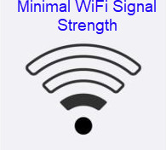
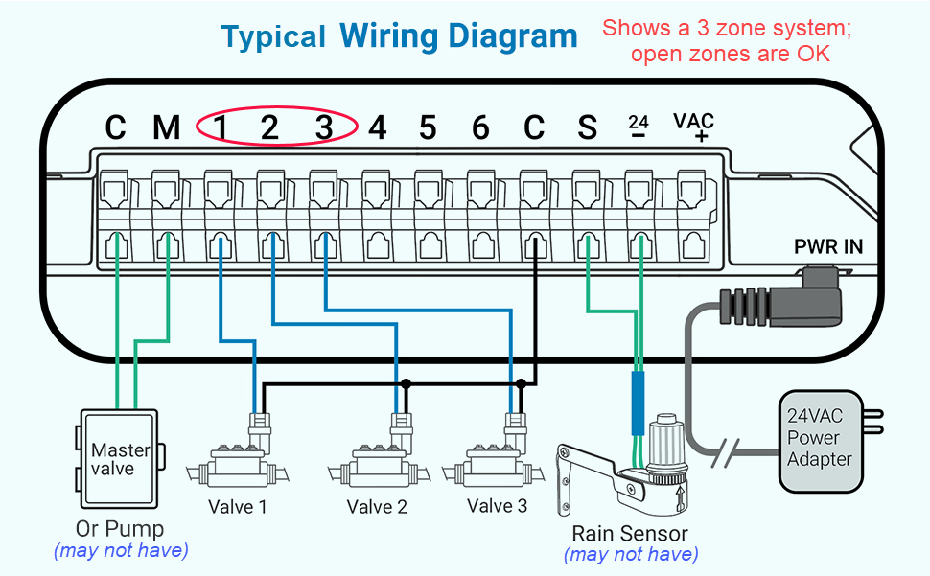
What do you need to get started?
Check for good WiFi signal at controller location
Know the number of Zones that you have – purchase a unit with at least that number of zone – extra zones are OK
Photograph current wires, write down your current programming (minutes per zone, times per week, etc)
Manually run each zone to make sure all zones are working with current controller
Then follow instruction to replace controller; connect to WiFi, installation & setup via phone app.
Three Wires connected to “Numbered Screws”, so three zones needed – you will probably have 4 to 12 zones currently

Slide 23
The Water Wise Project:
Part of Sustainable Skidaway
Skidaway Audubon Phrase . . .
“Be A Part Of Something Good”

Slide 24
Resources:
Your Local Resource Center: www.LandingsWeather.com
Weather Underground: www.WeatherUnderground.com
Click ‘Maps & Radar’, then ‘Wonder Map’, click on Station, then ID for details
Rachio Controller: www.rachio.com
Install Video: https://www.youtube.com/watch?v=ya8JHP-GeeY
Programming Video: https://www.youtube.com/watch?v=Lbe8Kx_SIbo
Front Panel / Manual Control: https://www.youtube.com/watch?v=U0W4q22IyDA
Hunter Controller: www.hydrawise.com
Install Video: https://www.youtube.com/watch?v=qmnXflGeYzk
Programming Video: https://www.youtube.com/watch?v=3bS6H3u4BAg
Orbit Controller: www.orbitonline.com > collections > b-hyve
Install Video: https://www.youtube.com/watch?v=1qKpD3NR_XM
Programming Video: https://www.youtube.com/watch?v=67vHj3iNVno

Slide 25
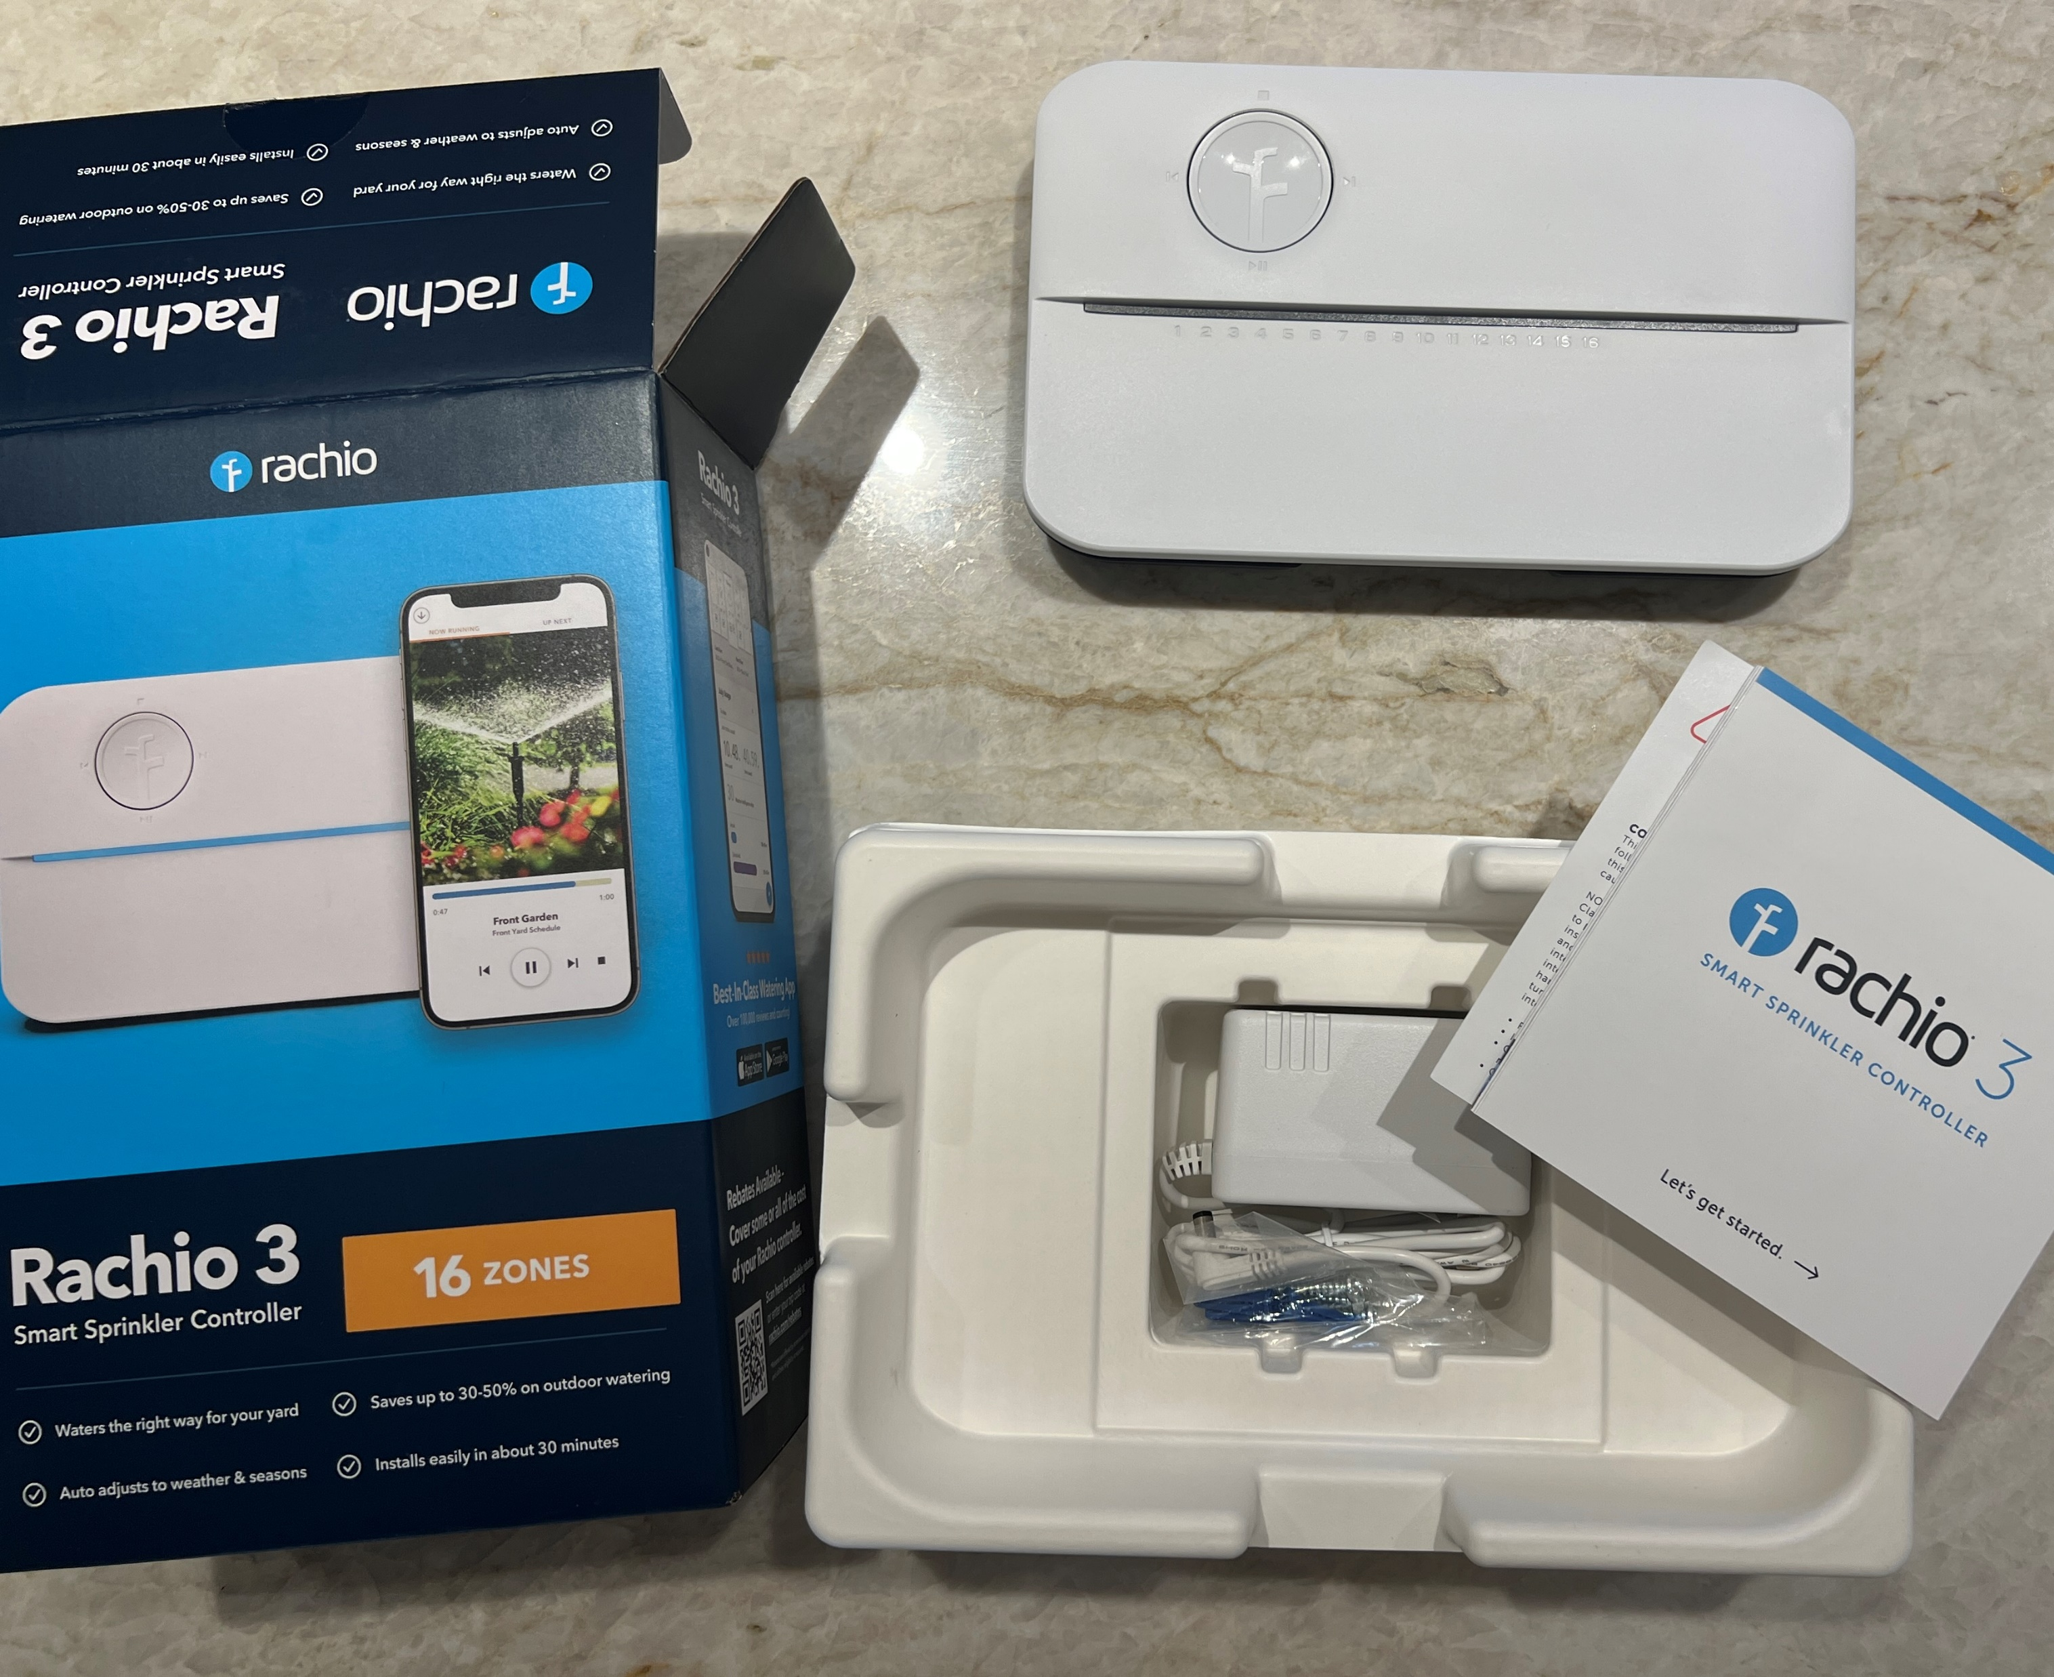
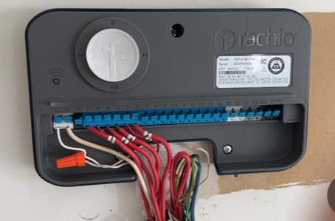
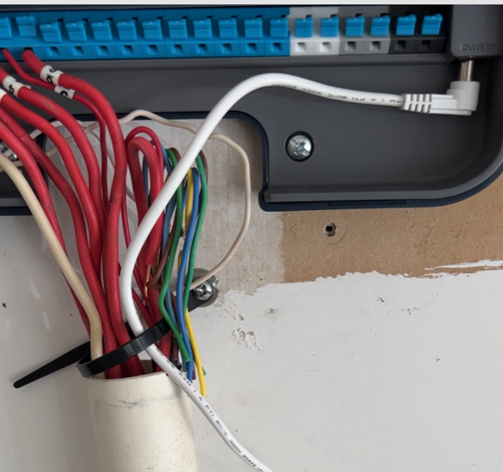
A Typical Rachio Install
Connect C wire(s) and numbered wires on new controller
This Rain Bird controller has terminals marked
24VAC, SENS, C, M, and 1,2,3,… 12
You only need to look for C (one or more white wires connected in Common to one screw) and wires at numbered screws, one for each zone – If you have a master valve (M) or a well pump note that as well - use tape to mark all wires before starting

Slide 26
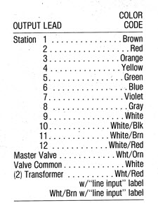
Older Rainbird Mechanical “Clock” Controller

